Slide 1
How Faiths Work
(and why it matters):
Stories, Commitments, Identities, Communities
with Clive Marsh

Slide 2
Opening point to ponder…
‘Even Christians no longer use ‘Christian’ as their first language.’
[A result of research undertaken by Revd Eleanor Jackson into the reception of Doctor Who.]

Slide 3
Opening point to ponder…
(possible responses…)
Nor should they, it really isn’t a problem!
Oh dear, what have we come to!
Good! It’s necessary for mission that they don’t.
Wow – British society really has changed!

Slide 4
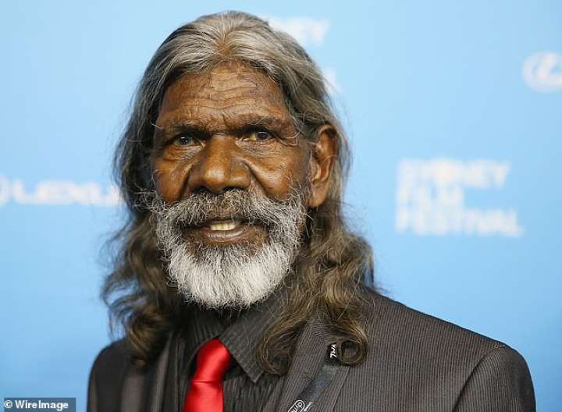
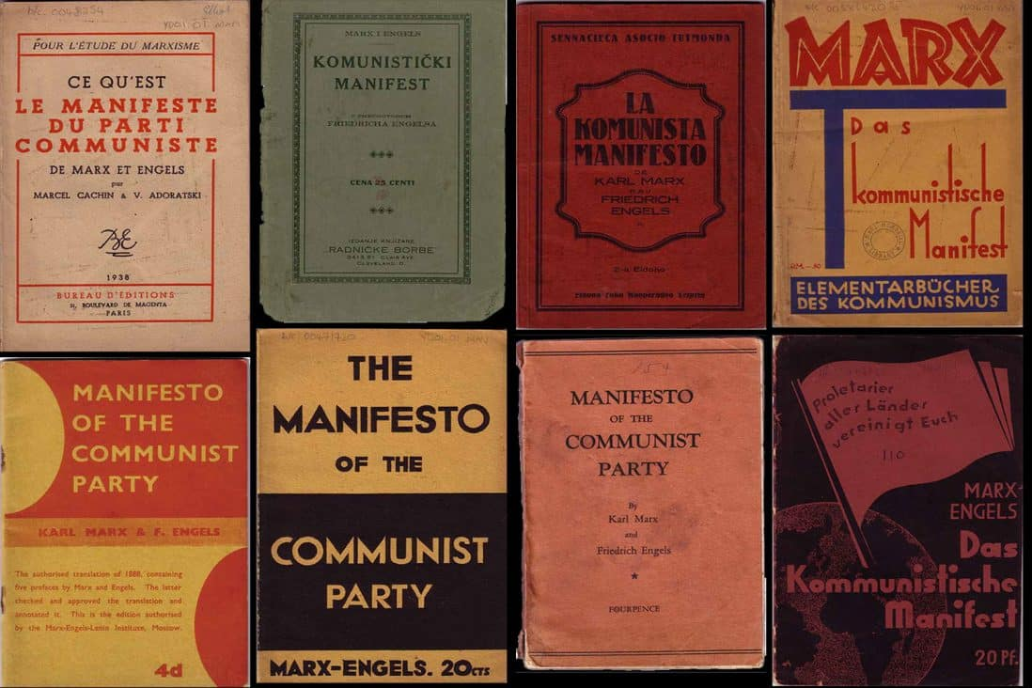
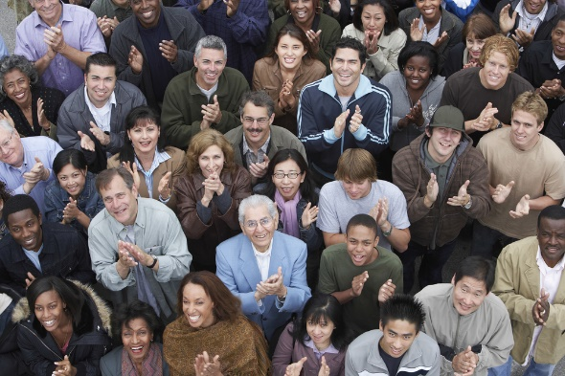
By way of introduction… (I): key themes
Stories
Commitments
Identities
Communities

Slide 5
By way of introduction… (II):
practices and contexts
Stephen Fry: Mythos and Heroes
The (sporting) liturgical year – Fixture list fixation
New Year resolutions / Gym membership
Music (radio, streaming, CDs, gigs…)
Film (cinema, Netflix, DVDs…)
Travel: rest v. pilgrimage v. carbon emissions
Ethnicity (White Privilege as a BIG problem)
LGBTQI+ (Relationships, Marriage & beyond)

Slide 6
An exercise
Have a close look at your ‘activity diary’. Any conclusions?
Compare notes with people near you. Any strong similarities or big differences? Any conclusions?
How (if at all) do your arts/culture activities interweave with your faith journey/development? (Any insights from this?)
As a group, come up with ONE clear insight about Christian formation today.

Slide 7
Reporting back…
And your insights are…?

Slide 8
Working out which stories matter (I)
Opt for ONE of the following statements:
A: There is only one, single Christian Story
B: There are only multiple Christian stories

Slide 9
Working out which stories matter:
Exercise 1
Within your group (A or B)…
Come up with:
All of the reasons you can think of why your position is right
What the consequences are (positive and negative) of holding your view

Slide 10
Reporting back…
And (some of) your answers are…?

Slide 11
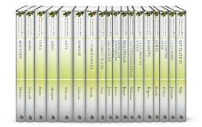
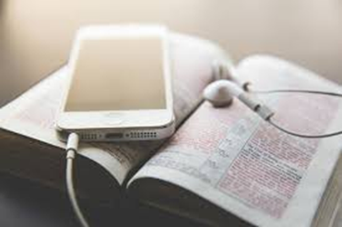
Working out which stories matter (II)
The Christian Story/Christian stories & the Biblical Story/biblical stories
Exploring ‘canons within the canon’
Being realistic about what ‘biblical’ (and being biblical) means
Coping with biblical (il)literacy in society (and church?)

Slide 12
Working out which stories matter (II)
Exercise 2
Individually… If you could only choose ONE of the 66 books of the Bible to keep, which would it be? (Think about why that is.)
In 2s and 3s… Compare your choices. You don’t need to argue your case. Simply listen to others’ reasons and present your own.

Slide 13
Our corporate ‘canon within the canon’ is…
Genesis Exodus Psalms Proverbs
Ecclesiastes Hosea
Matthew Mark Luke John
Acts Romans Galatians Philippians
James
What are your reflections on this?

Slide 14
Some reflections to work with
We (all!) live within multiple narratives
We don’t always recognise the narratives we live within
We therefore sometimes don’t recognise the values we live by
Non-religious narratives aren’t necessarily good or bad (but need testing!)
Bible/Scripture & the Christian Story/stories aren’t the same thing
A church is a community of interpretation (working with text & life)
God is in the world, so many narratives can be theological (‘of God’)
Prayerful reflection (individually and with others) enables flourishing
Our own flourishing is entangled with the flourishing of others

Slide 15
The final step
Look back over the whole of today
Choose ONE major piece of ‘new learning’ or a ‘fresh insight’ that you’ll take away with you
Choose ONE action point that’s the most significant/urgent for you

Slide 16
Bible reading: Philippians 4.4-13, 21-23
Hymn: Singing the Faith 161,
‘Speak, O Lord, as we come to you’

Slide 17
A closing prayer
Creative God,
through whose Word the Bible and the Christian Tradition exist
take our efforts to use the texts and traditions within which we live,
and our resolve to live for you,
in your world,
within many narratives,
and enable us, with patience, to hear what you say to us
as we seek to be ‘biblical’ in our many different ways
as a Church, and as your disciples in the world.
In the name of Christ, we pray. AMEN

